Slide 1
INFT 6903 Data Science
Week 9: Classification (Machine learning)/Part II
Dr. Tolga Ensari
Department of Computer and Information Sciences
Arkansas Tech University
E-mail: tensari@atu.edu

Slide 2
Outline
I. Classification algorithms:
Support Vector Machines (SVM)
Artificial Neural Networks (ANN)
Deep Learning (DL): Convolutional Neural Networks (CNN)
II. Research Opportunity in Data Science
Computational Intelligence and Machine Learning (CIML) Research Lab
III. References

Slide 3
I. Classification Algorithms
I. Classification Algorithms
Support Vector Machines (SVM):
Find a linear hyperplane (decision boundary) that will separate the data.

Slide 4
I. Classification Algorithms
One Possible Solution:

Slide 5
I. Classification Algorithms
Another possible solution:

Slide 6
I. Classification Algorithms
Other possible solutions:

Slide 7
I. Classification Algorithms
Which one is better?
B1 or B2?
How do you define better?

Slide 8
I. Classification Algorithms
Find hyperplane maximizes the margin => B1 is better than B2.

Slide 9
I. Classification Algorithms

Slide 10
I. Classification Algorithms
Linear SVM (Linear model):
Learning the model is equivalent to determining the values of
How to find from training data?

Slide 11
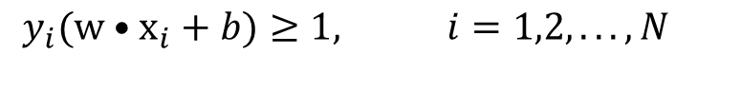
I. Classification Algorithms
Learning Linear SVM:
Objective is to maximize:
Which is equivalent to minimizing:
Subject to the following constraints:
or
This is a constrained optimization problem
Solve it using Lagrange multiplier method.
$$y_{i}(w•x_{i}+b)≥1, i=1,2,...,N$$

Slide 12
Example of Linear SVM:
I. Classification Algorithms
Support vectors

Slide 13
I. Classification Algorithms
Decision boundary depends only on support vectors
If you have data set with same support vectors, decision boundary will not change
How to classify using SVM once w and b are found? Given a test record, x_{i}

Slide 14
I. Classification Algorithms
What if the problem is not linearly separable?

Slide 15
I. Classification Algorithms
What if the problem is not linearly separable?
Introduce slack variables
Need to minimize:
Subject to:
If k is 1 or 2, this leads to similar objective function as linear SVM but with different constraints.

Slide 16
I. Classification Algorithms
Find the hyperplane that optimizes both factors.

Slide 17
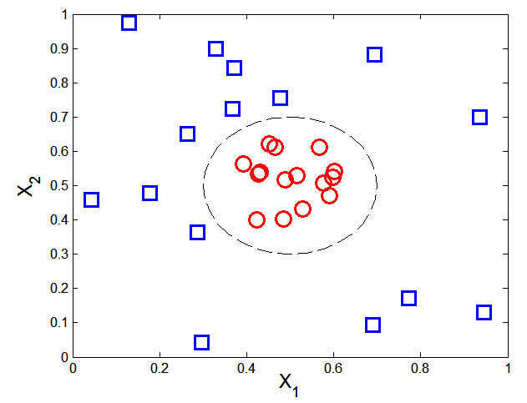
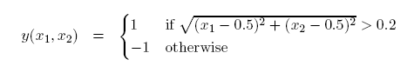
I. Classification Algorithms
What if decision boundary is not linear? → Nonlinear SVM

Slide 18
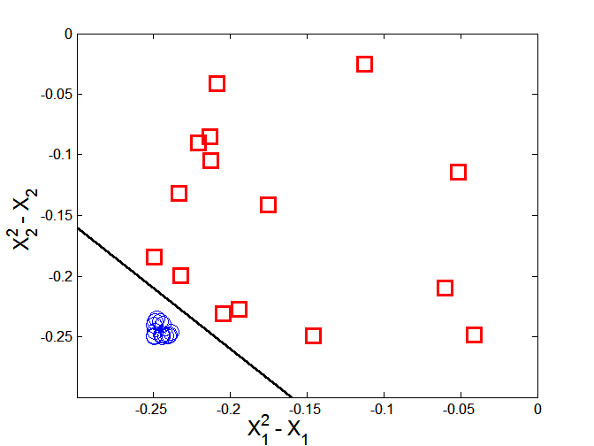
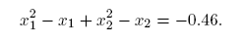
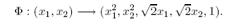
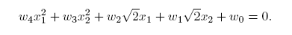
I. Classification Algorithms
Transform data into higher dimensional space
Decision boundary:

Slide 19
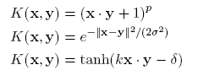
I. Classification Algorithms
Learning Nonlinear SVM:
Kernel Trick:
Φ(x_{i})• Φ(x_{j}) = K(x_{i}, x_{j})
K(x_{i}, x_{j}) is a kernel function (expressed in terms of the coordinates in the original space)
Example Kernel functions:

Slide 20
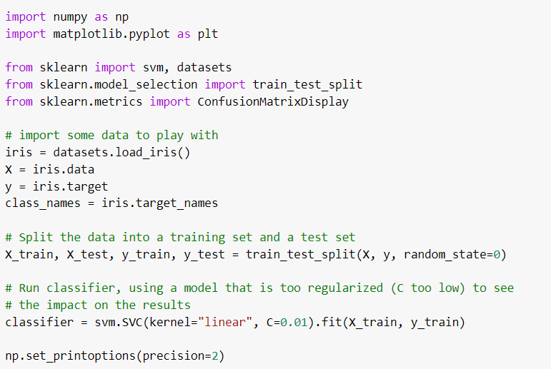
I. Classification Algorithms
Example: Implement the support vector machine (SVM) method to the Iris data set in
Python. Also, show the confusion matrix and normalized confusion matrix.

Slide 21
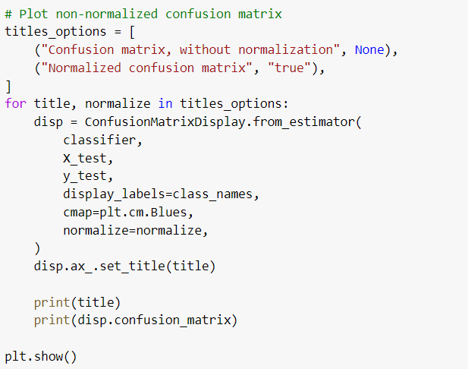
I. Classification Algorithms
(Cont.) Output:

Slide 22
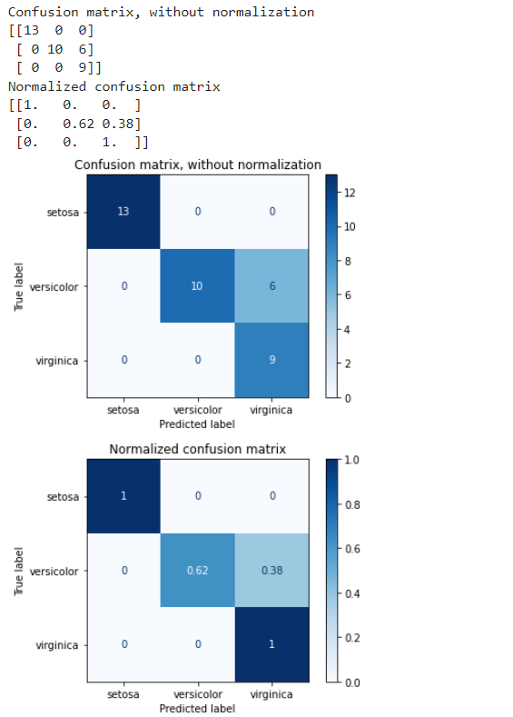
I. Classification Algorithms
(Cont.) Output:

Slide 23
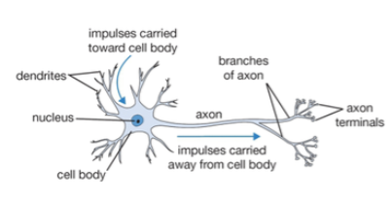
I. Classification Algorithms
Artificial Neural Networks (ANN):
It is a complex non-linear function can be learned as a composition of simple processing units (Human nerve system).
ANN is a collection of simple processing units (nodes) that are connected by
directed links (edges).
From: https://medium.com/nerd-for-tech/neural-networks-68531432fb5

Slide 24
I. Classification Algorithms
- Every node receives signals from incoming edges, performs computations, and transmits signals to outgoing edges.
- Analogous to human brain where nodes are neurons and signals are electrical impulses.
- Weight of an edge determines the strength of connection between the nodes.
- Simplest ANN is called Perceptron (single neuron).

Slide 25
Basic Architecture of Perceptron:
I. Classification Algorithms
Output
Weight coefficients
Activation Function
Inputs
Bias
It learns linear decision boundaries.
It is similar to logistic regression (activation function is sign instead of sigmoid).

Slide 26
Perceptron Example:
I. Classification Algorithms
Output Y is 1 if at least two of the three inputs are equal to 1.

Slide 27
I. Classification Algorithms

Slide 28
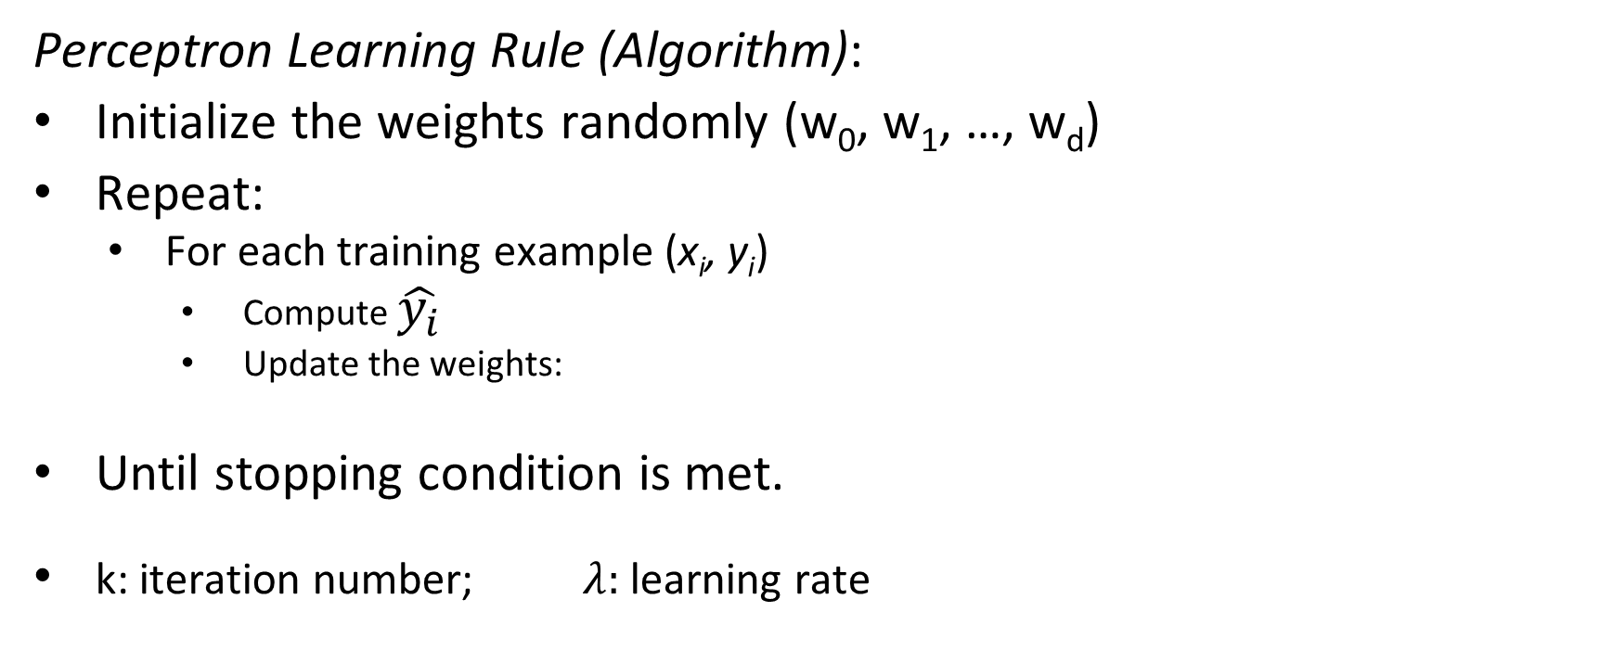
I. Classification Algorithms
Perceptron Learning Rule (Algorithm):
Initialize the weights randomly (w₀, w₁, …, w_{d})
Repeat:
For each training example (x_{i}, y_{i})
Compute $\hat{y_{i}}$
Update the weights:
Until stopping condition is met.
k: iteration number; $λ:$ learning rate
(Stopping conditions can be max number of iteration (like 5,000) or an error value (like Error=0.1)).

Slide 29
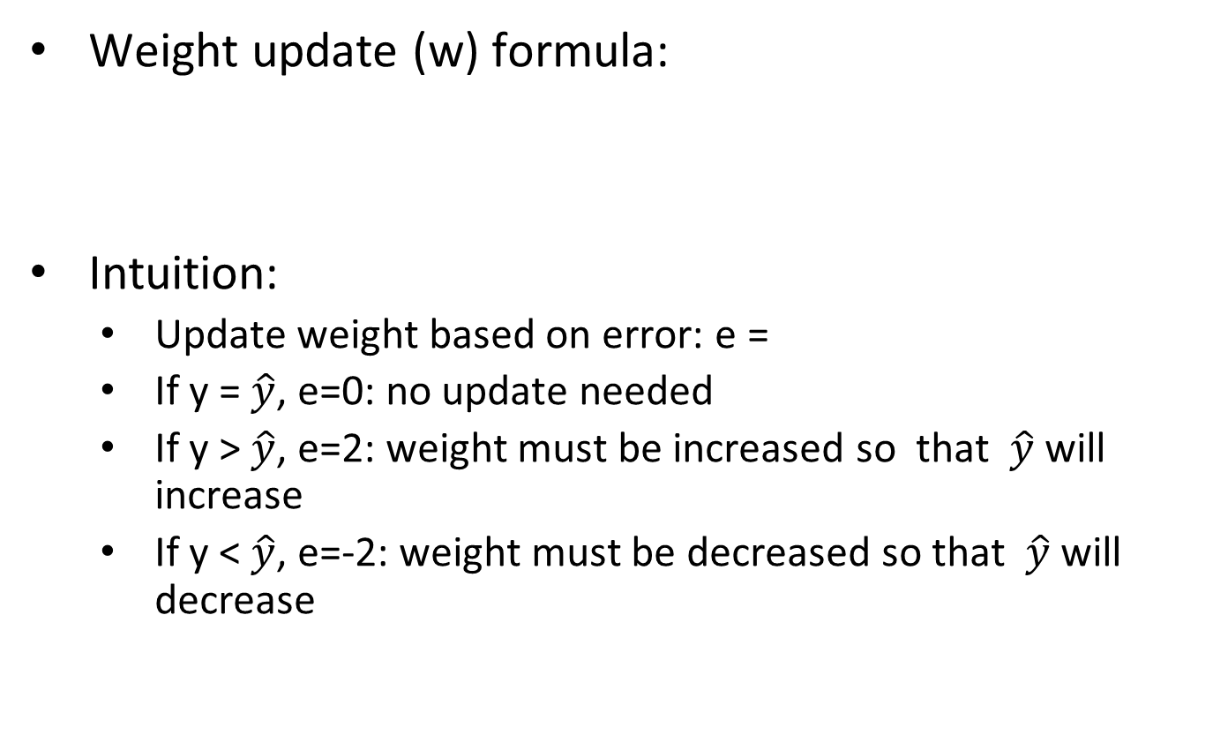
I. Classification Algorithms
Weight update (w) formula:
Intuition:
Update weight based on error: e =
If y = $\hat{y}$, e=0: no update needed
If y > $\hat{y}$, e=2: weight must be increased so that $\hat{y}$ will increase
If y < $\hat{y}$, e=-2: weight must be decreased so that $\hat{y}$ will decrease
y → Actual output y_hat → Target (desired) output

Slide 30
Example of Perceptron Learning:
I. Classification Algorithms
Weight updates over all epochs
Weight updates over first epoch

Slide 31
I. Classification Algorithms
Since y is a linear combination of input variables, decision boundary is linear.
For nonlinearly separable problems, perceptron learning algorithm will fail because no linear hyperplane can separate the data perfectly.

Slide 32
Nonlinearly Separable Data:
I. Classification Algorithms
XOR Data
Data set: Truth table of EXOR function

Slide 33
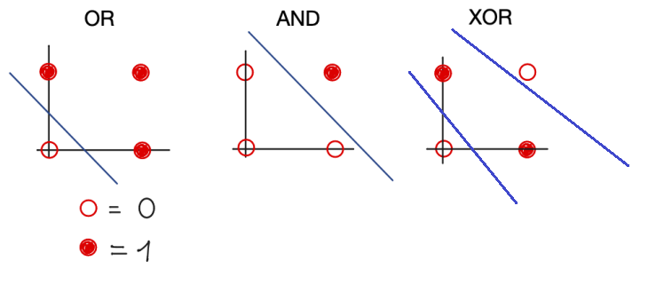
Nonlinearly Separable Data:
I. Classification Algorithms

Slide 34
Multi-layer Neural Network:
I. Classification Algorithms
More than one hidden layer of computing nodes
Every node in a hidden layer operates on activations from preceding layer and transmits activations forward to nodes of next layer
Also referred to as “feedforward neural networks”
Notes:
Hidden layers represent levels of abstraction. ANN models provide a natural way of representing features at multiple levels of abstraction, where complex features are seen as compositions of simpler features. In many classification problems, modeling such a hierarchy of features turns out to be very useful. For example, in order to detect a human face in an image, we can first identify low-level features such as sharp edges with different gradients and orientations. These features can then be combined to identify facial parts such as eyes, nose, ears, and lips. Finally, an appropriate arrangement of facial parts can be used to correctly identify a human face. ANN models provide a powerful architecture to represent a hierarchical abstraction of features, from
k lower levels of abstraction (e.g., edges) to higher levels (e.g., facial parts).

Slide 35
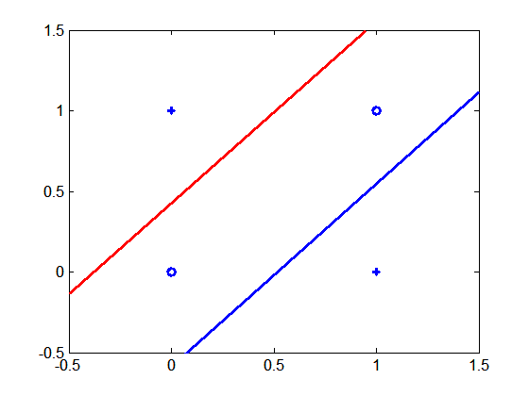
I. Classification Algorithms
Multi-layer neural networks with at least one hidden layer can solve any type of classification task involving nonlinear decision surfaces
XOR Data

Slide 36
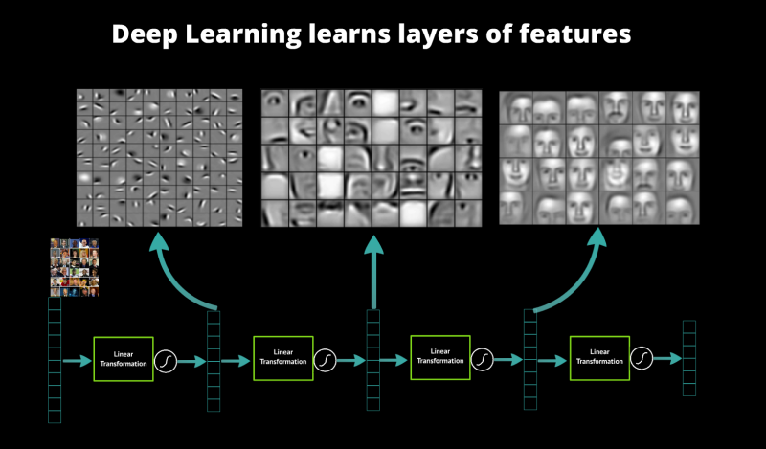
Why Multiple Hidden Layers?
I. Classification Algorithms
Activations at hidden layers can be viewed as features extracted as functions of inputs.
Every hidden layer represents a level of abstraction.
Complex features are compositions of simpler features.
Number of layers is known as depth of ANN.
Deeper networks express complex hierarchy of features.
Notes:
ANN models provide a natural way of representing features at multiple levels of abstraction, where complex features are seen as compositions of simpler features. In many classification problems, modeling such a hierarchy of features turns out to be very useful. For example, in order to detect a human face in an image, we can first identify low-level features such as sharp edges with different gradients and orientations. These features can then be combined to identify facial parts such as eyes, nose, ears, and lips. Finally, an appropriate arrangement of facial parts can be used to correctly identify a human face. ANN models provide a powerful architecture to represent a hierarchical abstraction of features, from
k lower levels of abstraction (e.g., edges) to higher levels (e.g., facial parts).

Slide 37
Multi-Layer Network Architecture:
I. Classification Algorithms
Activation value at node i at layer l
Activation Function
Linear Predictor

Slide 38
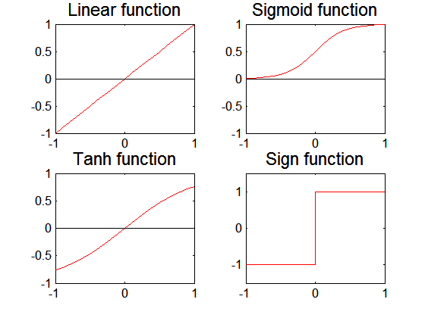
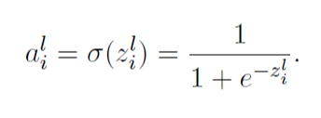
Activation Functions:
I. Classification Algorithms

Slide 39
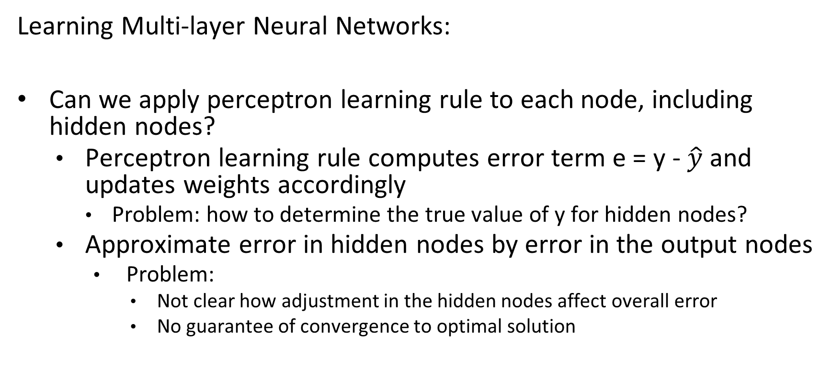
I. Classification Algorithms
Learning Multi-layer Neural Networks:
Can we apply perceptron learning rule to each node, including hidden nodes?
Perceptron learning rule computes error term e = y - $\hat{y}$ and updates weights accordingly
Problem: how to determine the true value of y for hidden nodes?
Approximate error in hidden nodes by error in the output nodes
Problem:
Not clear how adjustment in the hidden nodes affect overall error
No guarantee of convergence to optimal solution

Slide 40
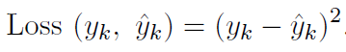
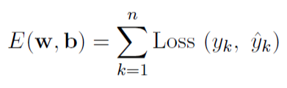
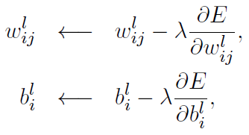
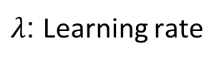
Gradient Descent method:
I. Classification Algorithms
Squared Loss:
Loss Function to measure errors across all training points
Gradient descent: Update parameters in the direction of “maximum descent” in the loss function across all points
Stochastic gradient descent (SGD): update the weight for every instance (minibatch SGD: update over min-batches of instances)
$λ$: Learning rate

Slide 41
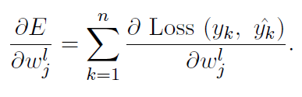
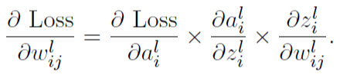
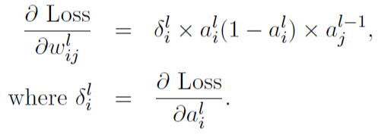
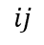

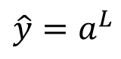
Computing Gradients:
I. Classification Algorithms
$$\hat{y}=a^{L}$$
$$ij$$
$$ij$$
Using chain rule of differentiation (on a single instance):
For sigmoid activation function:

Slide 42
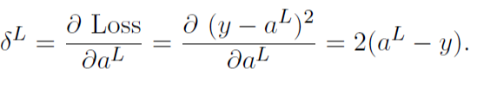
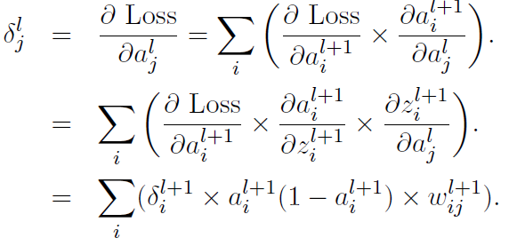
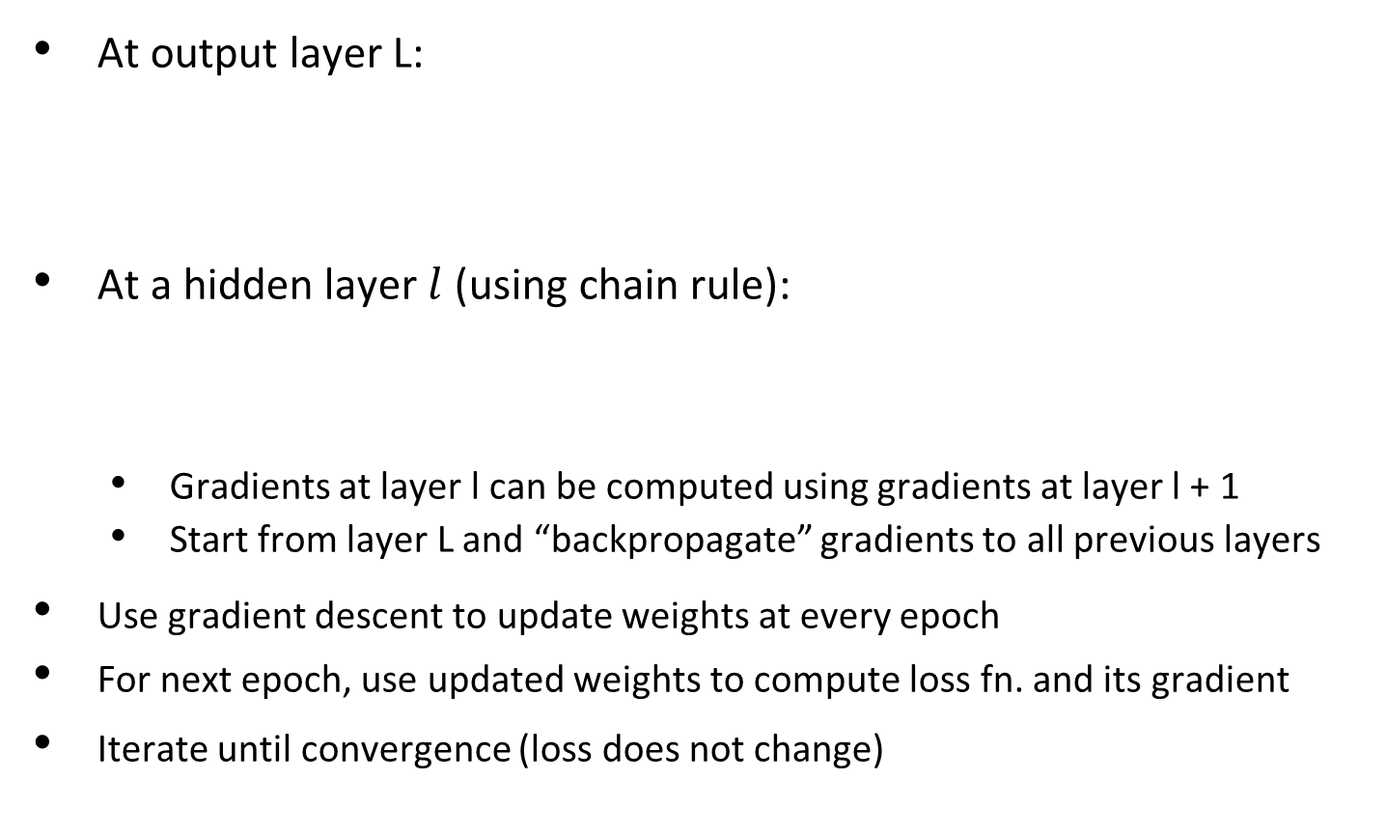
Backpropagation Algorithm:
I. Classification Algorithms
At output layer L:
At a hidden layer $l$ (using chain rule):
Gradients at layer l can be computed using gradients at layer l + 1
Start from layer L and “backpropagate” gradients to all previous layers
Use gradient descent to update weights at every epoch
For next epoch, use updated weights to compute loss fn. and its gradient
Iterate until convergence (loss does not change)

Slide 43
Design Issues in ANN:
I. Classification Algorithms
Number of nodes in input layer:
One input node per binary/continuous attribute
k or log₂ k nodes for each categorical attribute with k values
Number of nodes in output layer:
One output for binary class problem
k or log₂ k nodes for k-class problem
Number of hidden layers and nodes per layer.
Initial weights and biases.
Learning rate, max. number of epochs, mini-batch size for mini-batch SGD, …

Slide 44
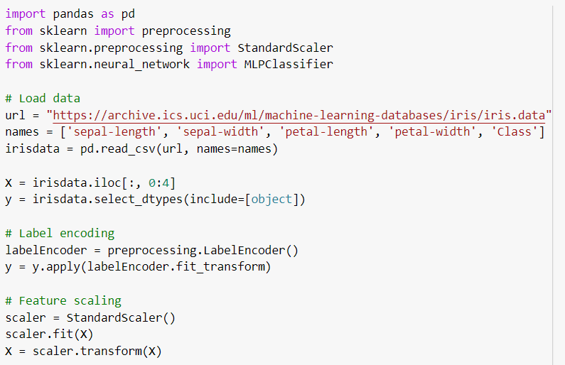
I. Classification Algorithms
Example: Implement artificial neural networks (ANN) method to the Iris data set.

Slide 45
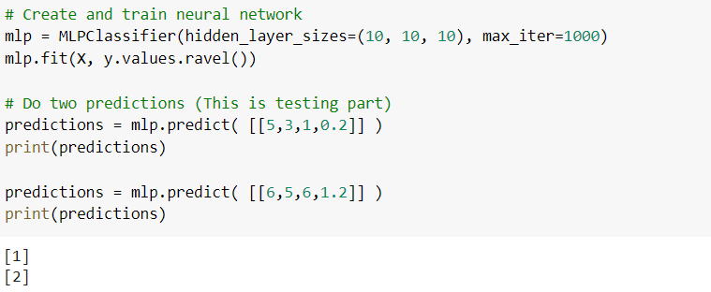
I. Classification Algorithms
(Cont.):
Output

Slide 46

I. Classification Algorithms
Keras: https://keras.io
Keras is a neural network Application Programming Interface (API) for Python that is tightly integrated with TensorFlow, which is used to build machine learning models.
Keras' models offer a simple,
user-friendly way to define a
neural network, which will
then be built for you by
TensorFlow.

Slide 47

I. Classification Algorithms
Keras has lots code examples (https://keras.io/examples) in computer vision, natural language processing (NLP), Structured data, Time series, Audio data, Generative deep learning, Reinforcement learning, graph data, etc.

Slide 48
Deep Learning (DL):
I. Classification Algorithms
Training deep neural networks (more than 5-10 layers) could only be possible in recent times with:
Faster computing resources (Graphical process unit-GPU)
Larger labeled training sets
Algorithmic Improvements in Deep Learning
Recent Trends in DL:
Specialized ANN Architectures:
Convolutional Neural Networks (CNN), Recurrent Neural Networks (RNN), …
Unsupervised Models: Autoencoders (AE)
Generative Models: Generative Adversarial Networks (GAN)

Slide 49

I. Classification Algorithms
Convolutional Neural Networks (CNN) are the dominant paradigm in deep learning models for computer vision and others.
Originally proposed by Yann LeCun in the 1990s [LeCun95].
Hidden layers perform convolutions on their input.
Convolutional layers have a far smaller number of parameters, compared to fully-connected layers.
Fewer parameters can be trained with smaller amounts of data.
Credit: figure from apple.com developer website.
Notes:
Credit: https://developer.apple.com/library/content/documentation/Performance/Conceptual/vImage/ConvolutionOperations/ConvolutionOperations.html

Slide 50

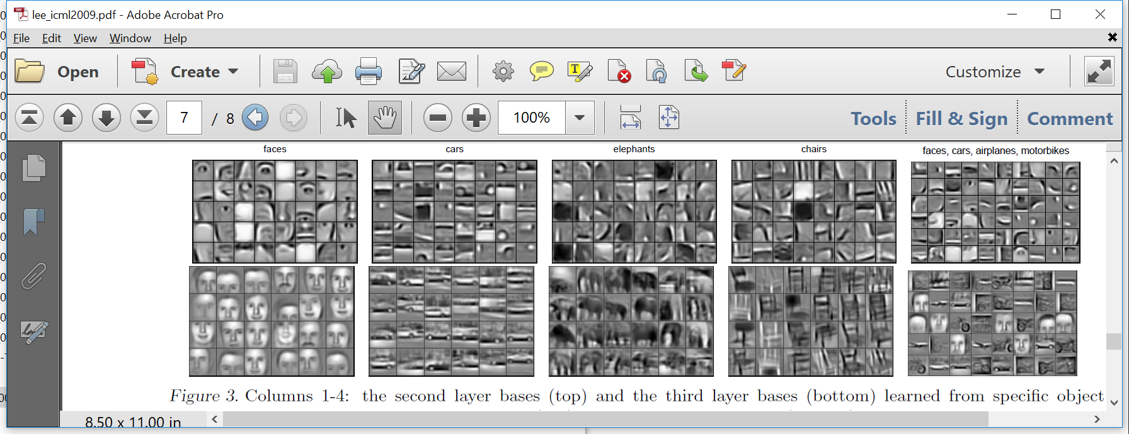
I. Classification Algorithms
CNN Visualization:
Visualization of a deep neural network trained with face images.
Credit for feature visualizations: [Lee09] Honglak Lee, Roger Grosse, Rajesh Ranganath and Andrew Y. Ng., ICML 2009.
Early layers, extract simple features.
Middle layers, model shape parts.
Last layers, model (almost) entire faces.
Input
Output

Slide 51
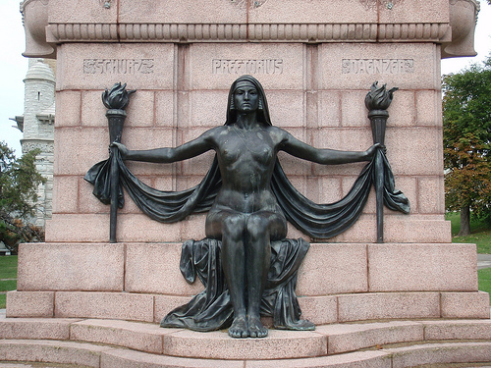
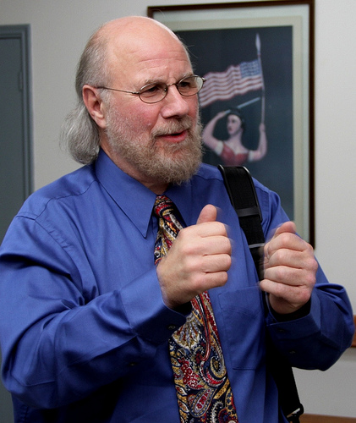
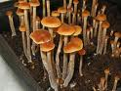

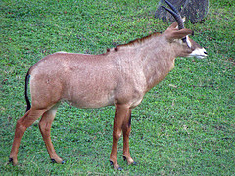
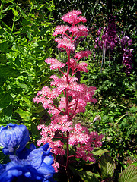
Success Stories – ImageNet:
I. Classification Algorithms
Task: classify each image into over 1,000 categories.
Before deep learning: 25% error rate.
2012: deep learning model, 16% error rate.
Had a huge impact in the computer vision community.
Reference: [Kriz12] Alex Krizhevsky, Ilya Sutskever, and Geoffrey E. Hinton, NIPS 2012.
Now: under 5% error rate.
Images from the ImageNet dataset.

Slide 52








Success Stories – Face Recognition:
I. Classification Algorithms
99.6% accuracy in recognizing a dataset of 5,000 individuals.
Reference: [Kem16] Ira Kemelmacher-Shlizerman, Steve Seitz, Daniel Miller, Evan Brossard, CVPR 2016.
Face verification used for unlocking smartphones and laptops.
Social media websites identify people in photos.
Google Photos, Facebook…
Images from the MegaFace dataset

Slide 53
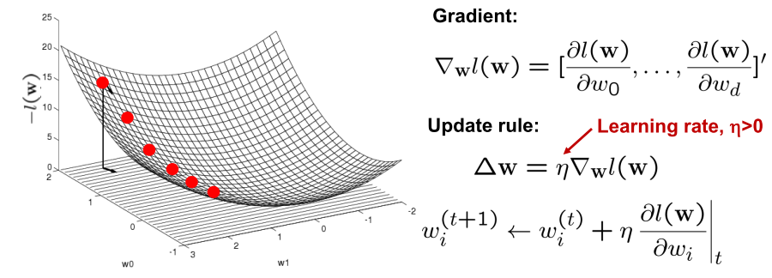
I. Classification Algorithms
Optimizing concave/convex function:
Maximum of a concave function = minimum of a convex function
Gradient descent (convex):

Slide 54
Neural Networks as a classifier:
I. Classification Algorithms
Weakness:
Long training time
Require a number of parameters typically best determined empirically, e.g., the network topology or “structure.”
Poor interpretability: Difficult to interpret the symbolic meaning behind the learned weights and of “hidden units” in the network
Strength:
High tolerance to noisy data
Ability to classify untrained patterns
Well-suited for continuous-valued inputs and outputs
Successful on a wide array of real-world data
Algorithms are inherently parallel
Techniques have recently been developed for the extraction of rules from trained neural networks.
Notes:
54

Slide 55
Convolution:
I. Classification Algorithms
These are the network parameters to be learned.
1 | -1 | -1
-1 | 1 | -1
-1 | -1 | 1
1 | 0 | 0 | 0 | 0 | 1
0 | 1 | 0 | 0 | 1 | 0
0 | 0 | 1 | 1 | 0 | 0
1 | 0 | 0 | 0 | 1 | 0
0 | 1 | 0 | 0 | 1 | 0
0 | 0 | 1 | 0 | 1 | 0
Filter 1
-1 | 1 | -1
-1 | 1 | -1
-1 | 1 | -1
Filter 2
……
6 x 6 image
Each filter detects a small pattern (3 x 3).

Slide 56
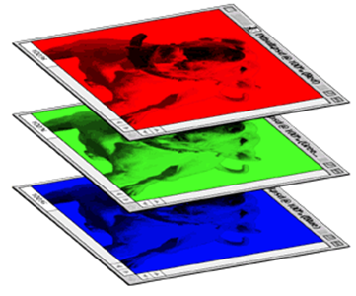
Color image: RGB 3 channels:
I. Classification Algorithms
1 | -1 | -1
-1 | 1 | -1
-1 | -1 | 1
-1 | 1 | -1
-1 | 1 | -1
-1 | 1 | -1
1 | -1 | -1
-1 | 1 | -1
-1 | -1 | 1
-1 | 1 | -1
-1 | 1 | -1
-1 | 1 | -1
1 | -1 | -1
-1 | 1 | -1
-1 | -1 | 1
-1 | 1 | -1
-1 | 1 | -1
-1 | 1 | -1
Filter 1
Filter 2
Color image
1 | 0 | 0 | 0 | 0 | 1
0 | 1 | 0 | 0 | 1 | 0
0 | 0 | 1 | 1 | 0 | 0
1 | 0 | 0 | 0 | 1 | 0
0 | 1 | 0 | 0 | 1 | 0
0 | 0 | 1 | 0 | 1 | 0
1 | 0 | 0 | 0 | 0 | 1
0 | 1 | 0 | 0 | 1 | 0
0 | 0 | 1 | 1 | 0 | 0
1 | 0 | 0 | 0 | 1 | 0
0 | 1 | 0 | 0 | 1 | 0
0 | 0 | 1 | 0 | 1 | 0
1 | 0 | 0 | 0 | 0 | 1
0 | 1 | 0 | 0 | 1 | 0
0 | 0 | 1 | 1 | 0 | 0
1 | 0 | 0 | 0 | 1 | 0
0 | 1 | 0 | 0 | 1 | 0
0 | 0 | 1 | 0 | 1 | 0

Slide 57


The whole CNN
cat dog ……
Convolution
Max Pooling
Can repeat many times
Fully Connected Feedforward network
Convolution
Max Pooling
Flattened

Slide 58
Max Pooling:
I. Classification Algorithms
1 | -1 | -1
-1 | 1 | -1
-1 | -1 | 1
-1 | 1 | -1
-1 | 1 | -1
-1 | 1 | -1
Filter 1
Filter 2
3
-1
-3
-1
-1
-1
-1
-1
-3
1
0
-3
-1
-1
-2
1
-3
-3
0
1
-1
-1
-2
1
3
-2
-2
-1
-1
0
-4
3

Slide 59


Why Pooling:
I. Classification Algorithms
Subsampling pixels will not change the object.
bird
bird
Subsampling
We can subsample the pixels to make image smaller
fewer parameters to characterize the image.

Slide 60
A CNN compresses a fully connected network in two ways:
I. Classification Algorithms
Reducing number of connections
Shared weights on the edges
Max pooling further reduces the complexity.

Slide 61
Max Pooling:
I. Classification Algorithms
New image
but smaller
1 | 0 | 0 | 0 | 0 | 1
0 | 1 | 0 | 0 | 1 | 0
0 | 0 | 1 | 1 | 0 | 0
1 | 0 | 0 | 0 | 1 | 0
0 | 1 | 0 | 0 | 1 | 0
0 | 0 | 1 | 0 | 1 | 0
Conv
3
0
-1
1
Max
Pooling
3
1
0
3
2 x 2 image
6 x 6 image
Each filter
is a channel

Slide 62
The whole CNN
3
0
-1
1
Convolution
3
1
0
3
Max Pooling
Can repeat many times
A new image
Convolution
Smaller than the original image.
The number of channels is the number of filters.
Max Pooling

Slide 63


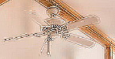

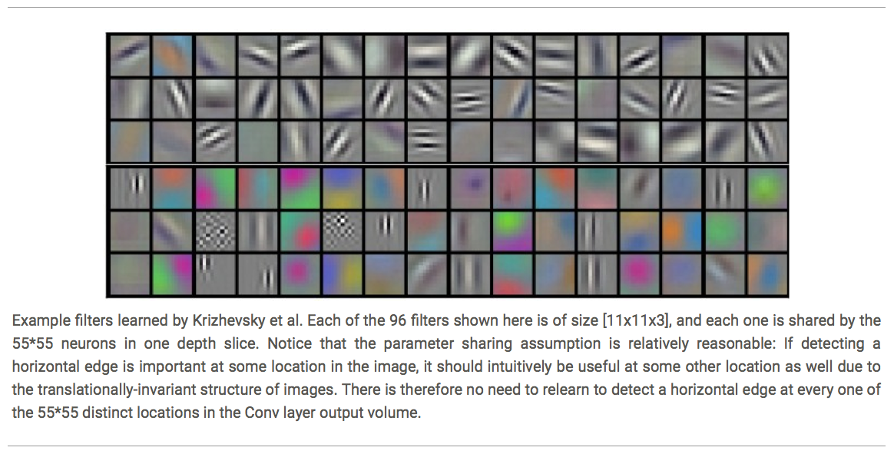
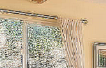
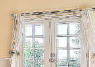


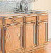








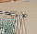
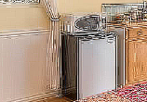
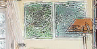
I. Classification Algorithms
DL applies a multi-layer process for learning rich hierarchical features (i.e., data representations).
Input image pixels → Edges → Textures → Parts → Objects
Low-Level Features
Mid-Level Features
High-Level Features
Trainable Classifier
Output
Slide credit: Param Vir Singh – Deep Learning

Slide 64


I. Classification Algorithms
When the convolutional filters are scanned over the image, they capture useful features
E.g., edge detection by convolutions.
Filter
0 1 0
1 -4 1
0 1 0
Input Image
Convoluted Image
Slide credit: Param Vir Singh – Deep Learning

Slide 65
I. Classification Algorithms
Feature extraction architecture:
After 2 convolutional layers, a max-pooling layer reduces the size of the feature maps (typically by 2)
A fully convolutional and a softmax layers are added last to perform classification
Living Room
Bedroom
64
64
128
128
256
256
256
512
512
512
512
512
512
Kitchen
Bathroom
Conv layer
Max Pool
Outdoor
Fully Connected Layer
Slide credit: Param Vir Singh – Deep Learning

Slide 66
I. Classification Algorithms
Deep learning (DL) algorithms:
- Convolutional neural networks (CNN)
- Recurrent neural networks (RNN)
- Restricted Boltzmann Machines (RBM)
- Autoencoder (AE)
- Generative Adversarial Networks (GAN)
- Long Short-Term Memory (LSTM)
- Deep Belief Networks (DBN)

Slide 67

I. Classification Algorithms
Example: Implement convolutional neural networks (CNN) on the MNIST data set using Keras (from the Keras examples).
Sample images (digits) from the MNIST data set.
The MNIST database contains 60,000 training images and 10,000 testing images.

Slide 68


I. Classification Algorithms
(Cont.):

Slide 69

I. Classification Algorithms
(Cont.) Output:

Slide 70

I. Classification Algorithms
(Cont.):

Slide 71

I. Classification Algorithms
(Cont.) Output:

Slide 72

I. Classification Algorithms
(Cont.):

Slide 73

I. Classification Algorithms
(Cont.) Output:

Slide 74

I. Classification Algorithms
(Cont.):
Output

Slide 75
II. Research Opportunity in Data Science
- In the near future… Machine learning algorithms will run on most devices.
- Job markets:
Data Science market size is $62 billion in 2022.
(By Gartner: Technology research and consulting company).
- Governments, giant tech companies and most of other IT companies have
their own AI groups/studies/strategies.

Slide 76

II. Research Opportunity in Data Science
Computational Intelligence and Machine Learning (CIML) Research Lab:
https://ciml.group
Please visit the
CIML Lab web site
(https://ciml.group)
and see the lab’s
academic activities.
(We update our website
nowadays).

Slide 77
II. Research Opportunity in Data Science
If you are interested in working at the CIML Lab, please send me an email: tensari@atu.edu
- You can also see my publications/citations from the Google Scholar link:
https://scholar.google.com/citations?user=o-TS7FsAAAAJ&hl=en&oi=ao
- I have been studying in machine learning/AI research area since 2000
(Starting from MSc degree → 20+ experience).

Slide 78
II. Research Opportunity in Data Science
Your benefits from this research group:
- You can …
be a researcher in Data Science and learn more.
work in the research projects.
write a project proposal with lab the members.
write and publish scientific conferences/journals with the lab members.
build your CV with the publications and many academic activities.
organize a workshop/conference with the team members.
organize special sessions in a scientific conference.
add ‘I work at the professional research lab’ note in your CV.
can write my name as a reference for your future degree/job applications.
After your graduation, you can reach me out anytime via email or LinkedIn.

Slide 79
II. Research Opportunity in Data Science
Thank you so much for choosing this class in the summer!
You can always reach me out via email or my LinkedIn account in the future.

Slide 80
VI. References
Introduction to Data Mining, Tan, Steinbach, Karpatne, Kumar.
Michigan State University, Data Mining, http://www.cse.msu.edu/~ptan/dmbook/software
- https://scipy-lectures.org/
- Scikit Learn Data Science Library, https://scikit-learn.org/
- V. Athitsos, Vision, Learning, and Mining Lab, University of Texas at Arlington, 2018.
NumPy Library
- Keras Library/API
- Neural Networks, Tom Mitchell, Han, and Kamber
- L. Deng, Microsoft Research, 2013.
- A. Vakanski, University of Idaho, CS 404/504.
- www.medium.com

